Slide 1
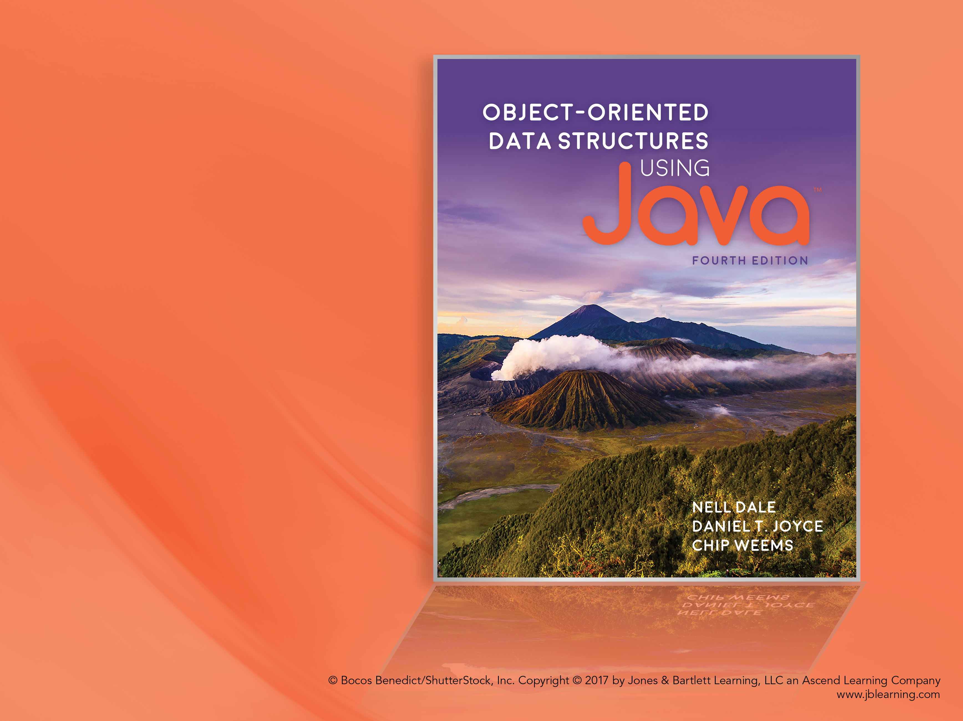
Chapter 5 The CollectionADT

Slide 2
Chapter 5: The Collection ADT
5.1 – The Collection Interface
5.2 – Array-Based Collections Implementation
5.3 – Application: Vocabulary Density
5.4 – Comparing Object Revisited
5.5 – Sorted Array-Based Collection Implementation
5.6 – Link-Based Collection Implementation
5.7 – Collection Variations

Slide 3
5.1 The Collection Interface
Stacks and queues restrict access to data based on the order in which the data was stored
Sometimes we need to retrieve information regardless of the order in which it is stored—content based access—for example obtaining student information based on an ID number
the Collection ADT is the most basic ADT that provides the required functionality

Slide 4
Assumptions for our Collections
Support addition, removal, and retrieval of elements
Content based access is based on equality of objects (using the equals method)
Allow duplicate elements, do not allow null elements
add and remove operations return a boolean indicating success

Slide 5
package ch05.collections;
public interface CollectionInterface<T>
{
boolean add(T element);
// Attempts to add element to this collection. Returns true if successful, false otherwise.
T get(T target);
// Returns an element e from this collection such that e.equals(target).
// If no such element exists, returns null.
boolean contains(T target);
// Returns true if this collection contains an element e such that
// e.equals(target); otherwise returns false.
boolean remove (T target);
// Removes an element e from this collection such that e.equals(target)
// and returns true. If no such element exists, returns false.
boolean isFull();
boolean isEmpty();
int size();
}

Slide 6
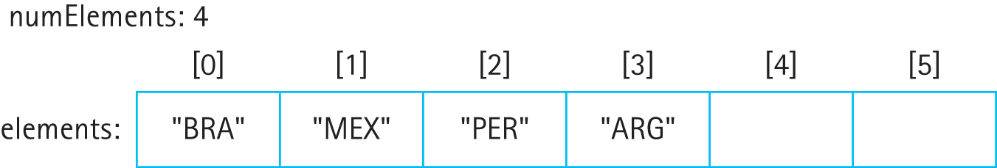
5.2 Array-Based Collection Implementation
Basic Approach - a collection of N elements is held in the first N locations of an array, locations 0 to N−1
Maintain an instance variable, numElements

Slide 7
Beginning of class
package ch05.collections;
public class ArrayCollection<T> implements CollectionInterface<T>
{
protected final int DEFCAP = 100; // default capacity
protected T[] elements; // array to hold collection's elements
protected int numElements = 0; // number of elements
// set by find method
protected boolean found; // true if target found, otherwise false
protected int location; // indicates location of target if found
public ArrayCollection()
{
elements = (T[]) new Object[DEFCAP];
}
public ArrayCollection(int capacity)
{
elements = (T[]) new Object[capacity];
}
. . .

Slide 8
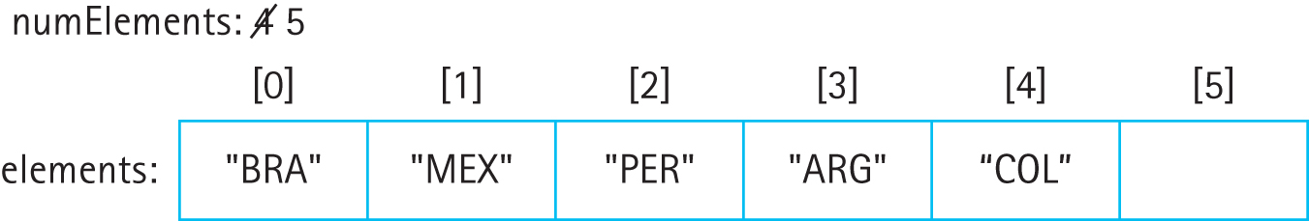
Adding an element
Add “COL”

Slide 9
The add method
public boolean add(T element)
// Attempts to add element to this collection.
// Returns true if successful, false otherwise.
{
if (isFull())
return false;
else
{
elements[numElements] = element;
numElements++;
return true;
}
}

Slide 10
The helper find method
protected access
uses Sequential Search … O(N)
sets instance variables found and location
simplifies
remove
contains
get

Slide 11
The helper find method
protected void find(T target)
{
location = 0;
found = false;
while (location < numElements)
{
if (elements[location].equals(target))
{
found = true;
return;
}
else
location++;
}
}

Slide 12
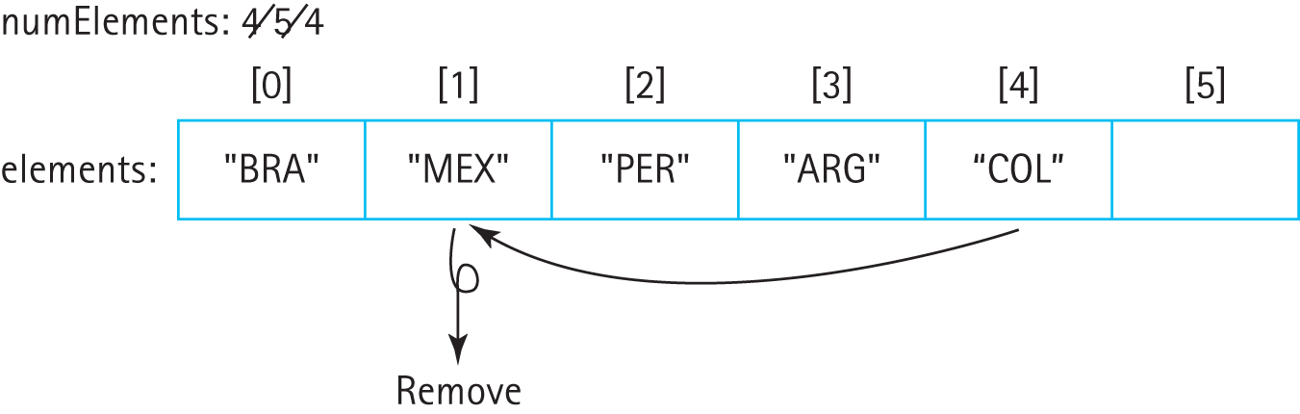
Removing an element
Remove “MEX”

Slide 13
The remove method
public boolean remove (T target)
// Removes an element e from this collection
// such that e.equals(target) and returns true;
// if no such element exists, returns false.
{
find(target);
if (found)
{
elements[location] = elements[numElements - 1];
elements[numElements - 1] = null;
numElements--;
}
return found;
}

Slide 14
The contains and get methods
public boolean contains (T target)
{
find(target);
return found;
}
public T get(T target)
{
find(target);
if (found)
return elements[location];
else
return null;
}

Slide 15
5.3 Application: Vocabulary Density
The vocabulary density of a text is the total number of words in the text divided by the number of unique words in the text.
Used by computational linguists to help analyze texts.
We define a word to be a sequence of letter characters (A through Z) plus the apostrophe character ( ’ ).

Slide 16
Vocabulary Density Calculation
Initialize variables and objects
while there are more words to process
Get the next word
if the collection does not contain the word
Add the word to the collection
Increment total number of words
Display (total number words/size of the collection)

Slide 17
The application
Instructors can now review the application, VocabularyDensity, found in the ch05.apps package, plus the notes on pages 307-308.
The code is short and simple—this is because so much of the complexity is handled by the ArrayCollection class. This is a good example of the power and utility of abstraction.

Slide 18
5.4 Comparing Objects Revisited
Collection operations require comparing objects for equality
Section 5.5 “Sorted Array-Based Collection Implementation” requires comparing objects for order
This section reviews the equals and compareTo operations

Slide 19
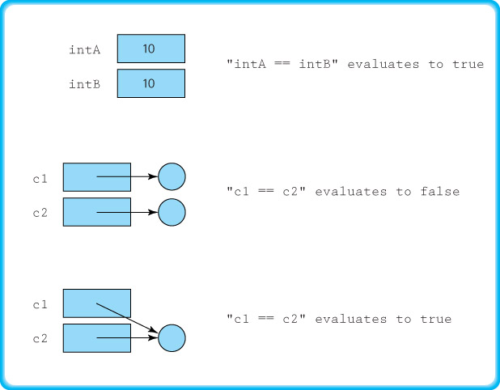
Using the comparison (==) operator

Slide 20
Using the equals method
Since equals is exported from the Object class it can be used with objects of any Java class.
For example, If c1 and c2 are objects of the class Circle, then we can compare them using
c1.equals(c2)
But this method, as defined in the Object class, acts much the same as the comparison operator. It returns true if and only if the two variables reference the same object.
However, we can redefine the equals method to fit the goals of the class.

Slide 21
Defining an equals method
A reasonable definition for equality of Circle objects is that they are equal if they have equal radii.
To realize this approach we define the equals method of our Circle class to use the radius attribute:
@Override
public boolean equals(Object obj)
{
if (obj == this)
return true;
else
if (obj == null || obj.getClass() != this.getClass())
return false;
else
{
Circle c = (Circle) obj;
return (this.radius == c.radius);
}
}

Slide 22
The FamousPerson class
A famous person object has attributes representing name (first name and last name), the year they were born, and some short interesting fact about the person
The class is in the support package
It exports getters plus equals, compareTo, and toString methods.

Slide 23
The equals method
@Override
public boolean equals(Object obj)
{
if (obj == this)
return true;
else
if (obj == null || obj.getClass() != this.getClass())
return false;
else
{
FamousPerson fp = (FamousPerson) obj;
return (this.firstName.equals(fp.firstName) &&
this.lastName.equals(fp.lastName));
}
}

Slide 24
Identifying objects
Objects are identified by their “key”.
The key of a class, from the point of view of an application, is the set of attributes that are used to determine the identity of an object of the class, for that application.
For example
the key of a Circle object is its radius attribute
the key of a FamousPerson object is the combination of its firstName and lastName attributes

Slide 25
Retrieving objects based on their key
Note that two objects can be equal although they are not identical
Keys form the basis of retrieval
Stored: Requested:
Instructors can review and demonstrate the CSInfo application found in the ch05.applications package
firstName: Ada
lastName: Lovelace
yearOfBirth: 1815
fact: first programmer
firstName: Ada
lastName: Lovelace
yearOfBirth: 0
fact:

Slide 26
Ordering objects
In addition to checking objects for equality, there is another type of comparison we need.
To support a sorted collection we need to be able to tell when one object is less than, equal to, or greater than another object.
The Java library provides an interface, called Comparable, which can be used to ensure that a class provides this functionality.

Slide 27
The Comparable Interface
The Comparable interface consists of exactly one abstract method:
public int compareTo(T o);
// Returns a negative integer, zero, or a positive
// integer as this object is less than, equal to,
// or greater than the specified object.
The compareTo method returns an integer value that indicates the relative "size" relationship between the object upon which the method is invoked and the object passed to the method as an argument.

Slide 28
A compareTo Example
public int compareTo(FamousPerson other)
// Precondition: 'other' is not null
//
// Compares this FamousPerson with 'other' for order. Returns a
// negative integer, zero, or a positive integer as this object
// is less than, equal to, or greater than 'other'.
{
if (!this.lastName.equals(other.lastName))
return this.lastName.compareTo(other.lastName);
else
return this.firstName.compareTo(other.firstName);
}
This compareTo method uses the compareTo method of the String class.
Note that the equals method and the compareTo method of our Circle class are compatible with each other.
By convention the compareTo method of a class should support the standard order of a class. We call the order established by a class compareTo method the natural order of the class.

Slide 29
5.5 Sorted Array-Based Collection Implementation
The ArrayCollection class features fast add (O(1)) but slow get, contains, and remove (O(N))
Many applications require fast retrieval (get and contains) as they access the collection repeatedly to obtain information
A sorted array approach permits use of the Binary Search for find, therefore speeding up both get and contains

Slide 30
Comparable Elements
We will use the compareTo method of the element class to keep underlying array sorted
We specify as a precondition of the add method that its argument is comparable to the previous objects added to the collection.

Slide 31
The SortedArrayCollection class
Similar to ArrayCollection class but …
Unbounded (uses a protected enlarge method)
the find method uses the Binary Search algorithm
cast elements as Comparable (some compilers may generate a warning)
add and remove must preserve the underlying order of the array (see next slide)

Slide 32
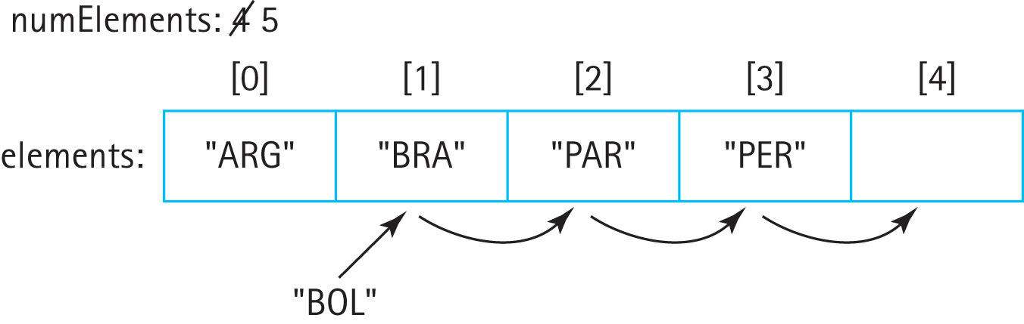
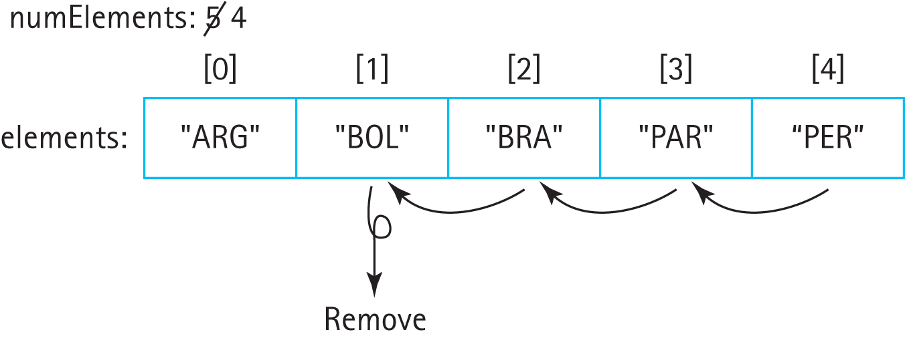
The add and remove operations
add “BOL”
remove “BOL”

Slide 33
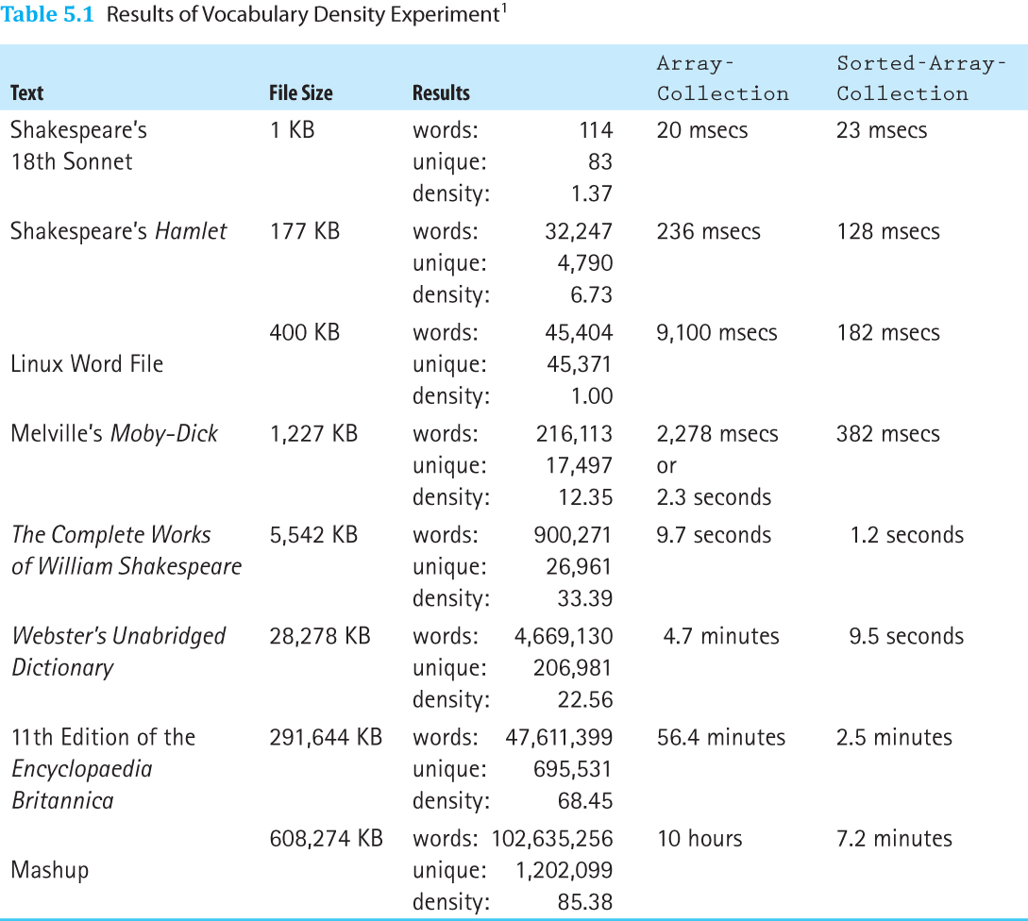
Sample Application Results

Slide 34
Implementing ADTs “by Copy” or “by Reference”
When designing an ADT we have a choice about how to handle the elements—“by copy” or “by reference.”
By Copy: The ADT manipulates copies of the data used in the client program. Making a valid copy of an object can be a complicated process.
By Reference: The ADT manipulates references to the actual elements passed to it by the client program. This is the most commonly used approach and is the approach we use throughout this textbook.

Slide 35
“By Copy” Notes
Valid copies of an object are typically created using the object's clone method.
Classes that provide a clone method must indicate this to the runtime system by implementing the Cloneable interface.
Drawbacks:
Copy of object might not reflect up-to-date status of original object
Copying objects takes time, especially if the objects are large and require complicated deep-copying methods.
Storing extra copies of objects also requires extra memory.

Slide 36
“By Reference” Notes
Because the client program retains a reference to the element, we say we have exposed the contents of the collection ADT to the client program.
The ADT allows direct access to the individual elements of the collection by the client program through the client program’s own references.
Drawbacks:
We create aliases of our elements, therefore we must deal with the potential problems associated with aliases.
This situation is especially dangerous if the client program can use an alias to change an attribute of an element that is used by the ADT to determine the underlying organization of the elements – for example if it changes the key value for an element stored in a sorted list.

Slide 37
An Example
The next three slides show the results of a sequence of operations when each of the two approaches is used to store a sorted list:
We have three objects that hold a person’s name and weight (Slide 1)
We add the three objects onto a list that sorts objects by the variable weight
We transform one of the original objects with a diet method, that changes the weight of the object

Slide 38
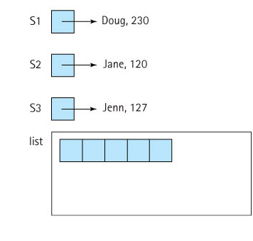
Example Step 1: The Three Objects
By Copy Approach By Reference Approach

Slide 39
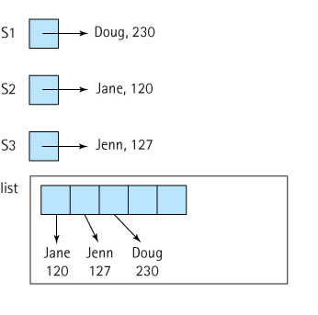
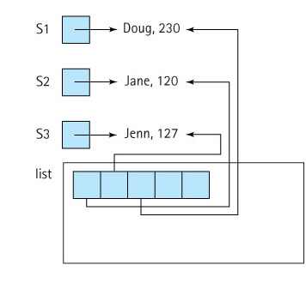
Example Step 2: Add Objects to List
By Copy Approach By Reference Approach

Slide 40
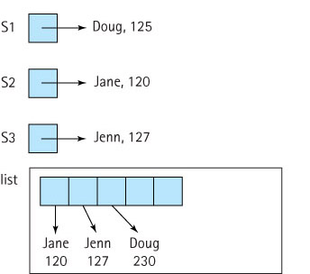
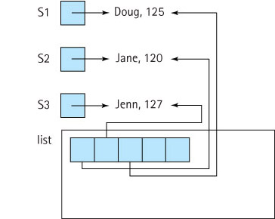
Example Step 3: S1.diet(-105)
By Copy Approach By Reference Approach
Problem: List copy is out of date
Problem: List is no longer sorted

Slide 41
Which approach is better?
That depends.
If processing time and space are issues, and if we are comfortable counting on the application programs to behave properly, then the “by reference” approach is probably best.
If we are not too concerned about time and space (maybe our list objects are not too large), but we are concerned with maintaining careful control over the access to and integrity of our lists, then the “by copy” approach is probably best.
The suitability of either approach depends on what the list is used for.

Slide 42
5.6 Link-Based Collection Implementation
Internal representation: unsorted linked list
Reuses design/code from previous classes
Code is in the ch05.collections package
The find method sets the boolean found plus two “pointers” if element is found: previous and location
The next slide lists array-based and link-based find side-by-side for comparison

Slide 43
Array-Based
Link-Based
protected void find(T target)
{
location = 0;
found = false;
while (location < numElements)
{
if elements[location].equals(target))
{
found = true;
return;
}
else
location++;
}
}
protected void find(T target)
{
location = head;
found = false;
while (location != null)
{
if (location.getInfo().equals(target))
{
found = true;
return;
}
else
{
previous = location;
location = location.getLink();
}
}
}

Slide 44
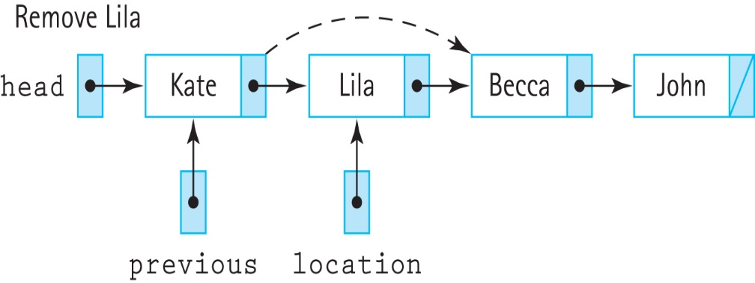
Removing an element
public boolean remove (T target)
{
find(target);
if (found)
{
if (head == location)
head = head.getLink(); // remove first node
else
previous.setLink(location.getLink()); // remove node at location
numElements--;
}
return found;
}

Slide 45
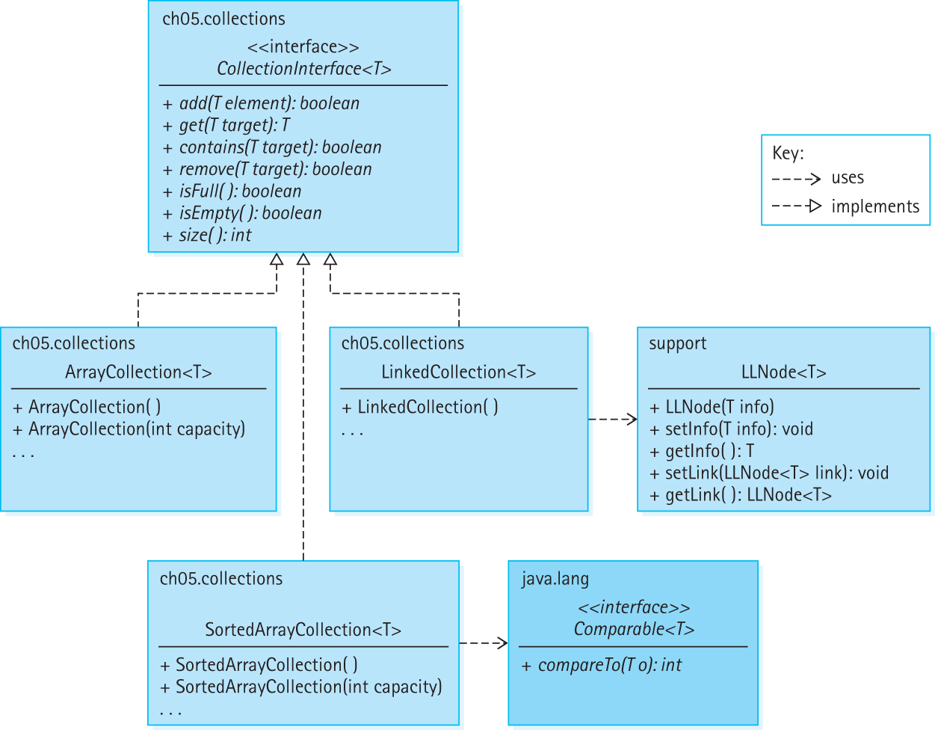
Our Collection Architecture

Slide 46
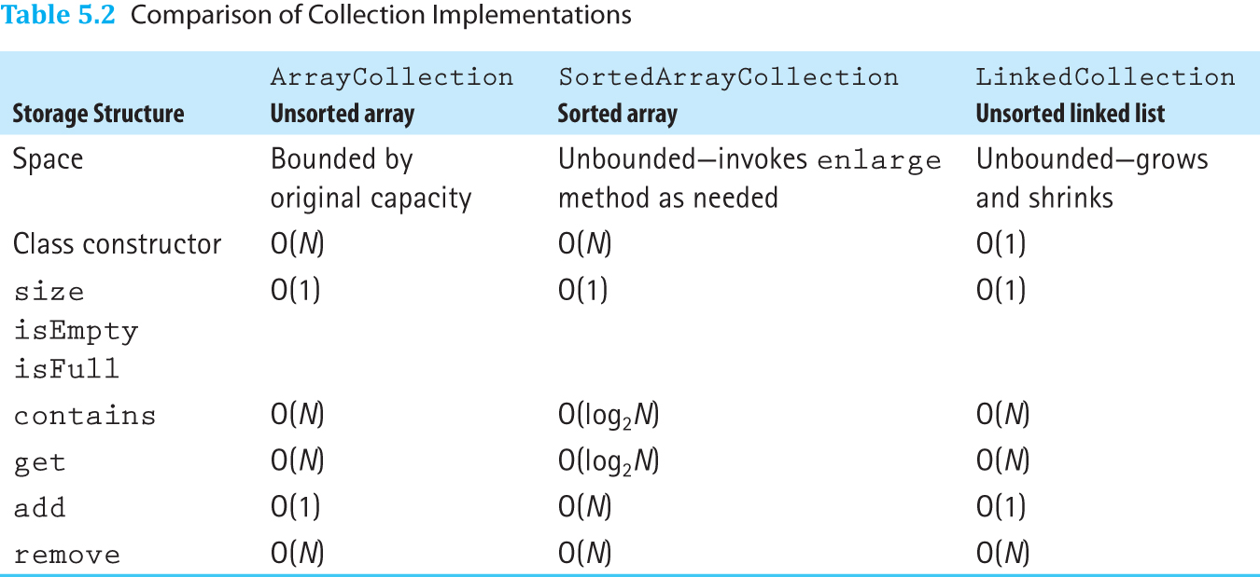
Comparing Collection Implementations

Slide 47
5.7 Collection Variations
The Collection ADT offers simple but crucial functionality–the ability to store and retrieve information.
This functionality sits at the heart of information processing.
Data structures, file systems, memory/storage, databases, the Cloud, the Internet all involve, at their core, storing and retrieving information.
There are many variations of collections, including the lists, search trees, maps, hash tables, and priority queues we study in the upcoming chapters

Slide 48
The Java Collections Framework
The Java library provides a robust collections framework
At the center of the framework is the Collection interface, found in the java.util package of the library. This interface supports 11 subinterfaces including Deque, List, and Set and has 33 implementing classes
If you are interested in learning more about the Java Collections Framework, reference the extensive documentation available at Oracle’s website.

Slide 49
The Bag ADT
On pages 332 and 333 we define a BagInterface that extends CollectionInterface with the additional methods grab, count, removeAll and clear
Implementation is left as an exercise

Slide 50
The BagInterface
package ch05.collections;
public interface BagInterface<T> extends CollectionInterface
{
T grab();
// If this bag is not empty, removes and returns a random
// element of the bag; otherwise returns null.
int count(T target);
// Returns a count of all elements e in this collection
// such that e.equals(target).
int removeAll(T target);
// Removes all elements e from this collection such that
// e.equals(target) and returns the number of elements removed.
void clear();
// Empties this bag so that it contains zero elements.
}

Slide 51
The Set ADT
Our collection ADTs allow duplicate elements. If we disallow duplicate elements, we have a collection commonly known as a Set.
The Set ADT models the mathematical set that is typically defined as a collection of distinct objects.

Slide 52
Set ADT Implementations
We can implement a Set class by copying and changing the code from one of our collection implementations—the only method we need to change is the add method.
The new add method could be designed to check if the element argument is not already in the collection, and if not it would add the element and return true.
Otherwise, of course, it returns false.

Slide 53
Set ADT Implementations
We can also implement a Set class by extending a previous class and overwriting add
See BasicSet1 of the ch05.collections package, which extends the LinkedCollection class
We can also implement a Set class by wrapping a previous class and re-writing add
See BasicSet2 of the ch05.collections package, which wraps an object of the LinkedCollection class.

